Slide 1

Computer Graphics
Week 4: WebGL (1)

Slide 2
Sub Topics
Basic Graphics System
Graphics API
Graphics Pipeline
WebGL Introduction
  Programmable Pipeline
  GLSL introduction

Slide 3




Basic Graphics System
Memory
Memory
Frame Buffer
Graphics Processor
(GPU)
Central Processor
(CPU)
Input Controls
Output Displays
Graphics are rendered
in the frame buffer

Slide 4
Modern Graphics Library
Performance is achieved by GPU (not CPU).
GPU is controlled through programs called shaders
The job of the application (like JavaScript) is to send data to the GPU.
GPU is the one who does the whole rendering process.

Slide 5
Some of Graphics Libraries
OpenGL ES
ES = Embedded Systems.
OpenGL ES version 1.0 is a simplification of OpenGL 2.1
OpenGL ES version 2.0 is a simplification of OpenGL 3.1 (shader-based)
WebGL 1.0 / 2.0
JavaScript Implementation of OpenGL ES version 2.0 / 3.0
WebGPU
It is based on APIs provided by Vulkan, Metal, and Direct 3D 12.

Slide 6
Web
Server
Web
Browser
Frame
Buffer
URL
HTML5
Canvas
Web Page
JS Engine
(Control Code)
GLSL ES
(Shader Code)
Computer Graphics App Execution Process through WebGL:
The execution involves web servers and browsers.

Slide 7
Describing Page
(HTML)
1
Accessing Canvas
Accessing supporting JS files
Define Shaders
(HTML)
2
Can be put in separate files (for example: .glsl file)
Computing or Specifying Data
(JS)
3
Sending Data
to GPU
(JS)
4
Rendering Data
(JS)
5
Computer Graphics App Execution Process through WebGL:
The execution involves web servers and browsers.

Slide 8
Practical Pipeline Architecture of Computer Graphics
1. Vertex Processing
2. Clipping and
Primitive Assembly
3. Rasterization
4. Fragment Processing
Vertices
Pixels

Slide 9
1. Vertex Processing
Object Coordinate
Eye/Camera Coordinate
Screen Coordinate
Most of the work executed in the Vertex Processing pipeline is converting the object representation from one coordinate system to another.
Any change in the coordinates is equivalent to a matrix transformation.

Slide 10
Projection (part of vertex processing)
Projection is a process combining a 3-dimensional object to produce a 2-dimensional image.
In Vertex Processing, the projection occurs when the object coordinates are converted to camera/eye coordinates.
There are two types of projections:
Perspective projection:
All projectors meet at a central point of projection
Parallel projection:
Projectors are parallel, the center of projection is replaced by the direction of projection

Slide 11
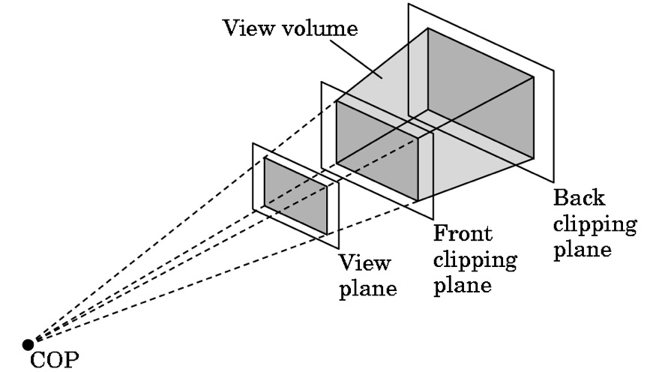
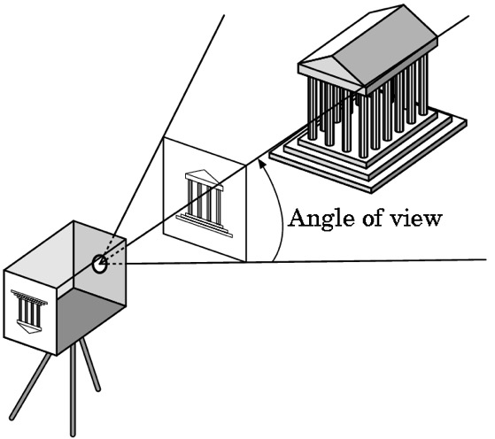
2. Clipping and Primitive Assembly
Just like cameras in the real world cannot “see” the whole scene, virtual cameras can see only part of the scene from the object space.
Objects that are not in the view volume are considered to be clipped out of the view.

Slide 12
2. Clipping and Primitive Assembly
Vertices need to be collected into geometric objects before the rasterization process.
Basic geometric objects or what so-called primitive assembly include:
Point
Line
Polygon
Curve
Surface

Slide 13
3. Rasterization
If an object is not clipped out, the corresponding pixels in the frame buffer must already be colored.
The rasterizer produces a set of fragments for each object.
Fragments are potential pixels, which:
Has a location in the frame buffer
Has color and depth attributes
The vertex attributes are interpolated across the object by the rasterizer.

Slide 14
4. Fragment Processing
The fragments that have been collected by the rasterizer are processed to determine the color of pixels associated with them in the frame buffer.
The colors can be determined by:
Texture Mapping or by
Interpolation of vertex colors.
A fragment may be covered by another fragment that is closer to the camera in depth. In this case, a hidden surface removal process needs to be carried out.

Slide 15
Introduction to WebGL
WebGL = Graphics API for the web
Three.js uses WebGL
WebGL is more difficult to use than Three.js
WebGL gives programmers full control over the hardware
Two versions of WebGL:
  WebGL 1.0 that is based on OpenGL ES 2.0
  WebGL 2.0 that is based on OpenGL ES 3.0
Two sides of WebGL programs:
  Part written in JavaScript
  Part written in GLSL that run on the GPU

Slide 16
The Programmable Pipeline
Old OpenGL API uses a fixed-function pipeline
Modern OpenGL introduced a programmable pipeline
WebGL uses a programmable pipeline, and it is mandatory
1. Vertex Processing
2. Clipping and
Primitive Assembly
3. Rasterization
4. Fragment Processing

Slide 17
The Programmable Pipeline
1. Vertex Processing
2. Clipping and
Primitive Assembly
3. Rasterization
4. Fragment Processing
The programs that are written as part of the pipeline are called shaders
  Vertex shader: called once for each vertex in a primitive
  Fragment shader: called once for each pixel in the primitive
WebGL pipeline also contains several stages from the original fixed-function pipeline
  For example, the depth test is still part of the fixed functionality, and it can be enabled or disabled in WebGL

Slide 18
The WebGL Graphics Context
It is a JavaScript object whose methods implement the JavaScript side of the WebGL API
A graphics context for WebGL 2.0 can be obtained by calling the function canvas.getContext("webgl2"), where canvas is a DOM object representing the canvas
    canvas = document.getElementById("webglcanvas");
    gl = canvas.getContext("webgl2");
    if ( ! gl ) {
    throw new Error("WebGL not supported; can't create graphics context.");
    }
    …
    <canvas width="800" height="600" id="webglcanvas"></canvas>

Slide 19
Sample init function called when the page is loaded (window.onload = init)
function init() {
try {
canvas = document.getElementById("webglcanvas");
gl = canvas.getContext("webgl2");
if ( ! gl ) {
throw new Error("WebGL not supported.");
}
}
catch (e) {
// report the error
return;
}
initGL(); // a function that initializes the WebGL graphics context,
// including creating and installing the shader programs
… // other JavaScript initialization
}

Slide 20
The Shader Program
Drawing with WebGL requires a shader program: a vertex shader and a fragment shader
Shaders are written in GLSL programming language that is based on the C programming language
The vertex shader and fragment shader are separate programs, each with its own main() function
The two shaders are compiled separately and then "linked" to produce a complete shader program
The JavaScript API for WebGL includes functions for compiling the shaders and then linking them

Slide 21
WebGL’s Program Object
var program = gl.createProgram();
gl.attachShader( program, vertexShader );
gl.attachShader( program, fragmentShader );
gl.linkProgram( program );
gl.useProgram( program );
It is a container for shaders.
It can load many shaders.
It can load other GLSL functions beside of the main shader functions.

Slide 22
Passing Shaders from CPU to GPU
Shaders are added to a program object to be compiled.
The common way to pass any shaders from CPU to GPU is by firstly writing their source code as a string inside an HTML document or JS file. Afterwards, the string is passed through gl.shaderSource ( shaderPointer, sourceCodeString) function.
If the source code is in an HTML document, then we can obtain and input it into the JS application through getElementById function.
The source code can also be written in a separate file. In this case, we may need to use a reader library such as Signals.js to convert the file into a string.

Slide 23
The Shader Program
To use the functions, the source code for the shaders must be JavaScript strings
Three steps to create the vertex shader
    let vertexShader = gl.createShader( gl.VERTEX_SHADER );
    gl.shaderSource( vertexShader, vertexShaderSource );
    gl.compileShader( vertexShader );
To check for compilation errors:
    gl.getShaderParameter( vertexShader, gl.COMPILE_STATUS )

Slide 24
The Shader Program
The fragment shader can be created in a similar way
    let fragmentShader = gl.createShader( gl.FRAGMENT_SHADER );
    gl.shaderSource( fragmentShader, fragmentShaderSource );
    gl.compileShader( fragmentShader );
The shaders need to be "attached" to the program object before linking:
    let prog = gl.createProgram();
    gl.attachShader( prog, vertexShader );
    gl.attachShader( prog, fragmentShader );
    gl.linkProgram( prog )

Slide 25
Typical Shader Creation Function
function createProgram(gl, vertexShaderSource, fragmentShaderSource) {
let vsh = gl.createShader( gl.VERTEX_SHADER );
gl.shaderSource( vsh, vertexShaderSource );
gl.compileShader( vsh );
if ( ! gl.getShaderParameter(vsh, gl.COMPILE_STATUS) ) {
throw new Error("Error in vertex shader: " + gl.getShaderInfoLog(vsh));
}
let fsh = gl.createShader( gl.FRAGMENT_SHADER );
gl.shaderSource( fsh, fragmentShaderSource );
gl.compileShader( fsh );
if ( ! gl.getShaderParameter(fsh, gl.COMPILE_STATUS) ) {
throw new Error("Error in fragment shader: " + gl.getShaderInfoLog(fsh));
}
let prog = gl.createProgram();
gl.attachShader( prog, vsh );
gl.attachShader( prog, fsh );
gl.linkProgram( prog );
if ( ! gl.getProgramParameter( prog, gl.LINK_STATUS) ) {
throw new Error("Link error in program: " + gl.getProgramInfoLog(prog));
}
return prog;
}

Slide 26
Shader Programs
Next step: tell the WebGL context to use the program
  If prog is a program identifier returned by the previous function, call
    gl.useProgram( prog );
We can create several shader programs then switch from one program to another at any time by calling gl.useProgram, even in the middle of rendering an image
  Three.js, for example, uses a different program for each type of Material
Shaders and programs that are no longer needed can be deleted to free up the resources they consume
    gl.deleteShader(shader)
    gl.deleteProgram(program)

Slide 27
Adding a (new) Vertex Shader
var vertexShader;
var vertexElement = document.getElementById( vertexShaderId ); // The source code is in the .html
vertexShader = gl.createShader( gl.VERTEX_SHADER );
gl.shaderSource( vertexShader, vertexElement.text );
gl.compileShader( vertexShader );
…
// After the shader program has been created
gl.attachShader( shaderProgram, vertexShader );

Slide 28
Previously on
IF184502 Computer Graphics
Describing Page
(HTML)
1
Accessing Canvas
Accessing supporting JS files
Define Shaders
(HTML)
2
Can be put in separate files (for example: .glsl file)
Computing or Specifying Data
(JS)
3
Sending Data
to GPU
(JS)
4
Rendering Data
(JS)
5
most likely reside in an Event Loop

Slide 29
Event Loop (in JS Application)
Every Function (in JS application) responsible to render graphics is an Event Listener or Callback Function.
In the case of static application, rendering is executed only once. Technically, it resides in the Event Listener of document.onload.
Later, as we want to develop dynamic applications: looped animation or interactive graphics, we need a method that is able to call our function recursively. Nevertheless, to start this recursion or event loop the method should be called at first under its parent scope once.

Slide 30
Shaders
There are two types of shader: Vertex and Fragment shaders.
Vertex shader should has at least a defined gl_Position variable.
Fragment shader should has at least a defined gl_FragColor variable.
Both of above shaders are full-state and independent programs.
Number 2, 3, 4, on vector or matrix data type represents dimension.
A precision config should be declared globally in the Fragment shader.

Slide 31
Shaders and Coordinate System
Vertex shader results in output in Clip Coordinates (3D).
Input to Fragment shader from Rasterizer is in the form of Window Coordinates (2D).
JS application may provide vertices data in any kinds of coordinate system. However, in the end, vertex shaders should produce gl_Position in the context of Clip Coordinates (3D).

Slide 32
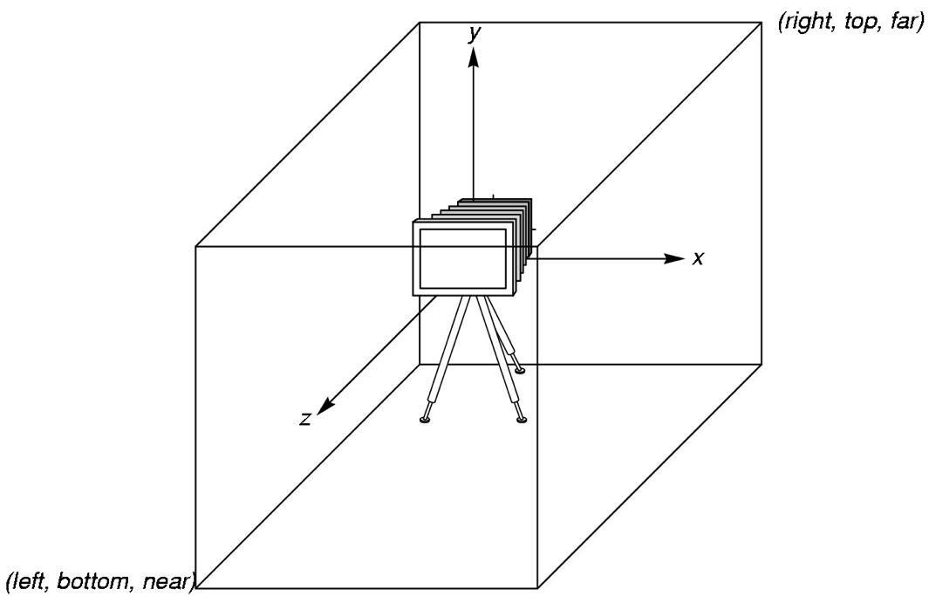
Shader’s Camera
Shaders locate a camera in the origin (0,0) of object space.
The camera face towards the negative of z axis.
The camera’s viewing volume is a 2x2x2 cube with the origin as its center.

Slide 33
OpenGL Shading Language
It is like C language, but equipped with special matrix and vector data types
01
Similar to Nvidia’s Cg and Microsoft HLSL
02
The source codes are sent from JS application to the GLSL shaders by the help of WebGL functions.
03
WebGL functions compile, link and provide information to the GLSL shaders.
04

Slide 34
Simple Vertex Shader
input from JS application
attribute vec4 aPosition;
void main(void)
{
gl_Position = aPosition;
}
linked to an input variable in JS application
Shader’s built-in variable

Slide 35
Vertex Shader Execution Model
Vertices data
for shader program
GPU
JS Application
Vertex Shader
Primitive
Assembly
gl.drawArrays
Vertices
(Clip Coordinate)

Slide 36
Simple Fragment Shader
precision configuration:
how much detail the colour interpolation
precision mediump float;
void main(void)
{
gl_FragColor = vec4(1.0, 0.0, 0.0, 1.0);
}
Shader’s built-in variable

Slide 37
Fragment Shader Execution Model
JS Application
Rasterizer
Fragment Shader
Frame Buffer
Fragment
Fragment Colour

Slide 38
GLSL Data Types
Just like C language: float, int, bool
Vector specific:
float: vec2, vec3, vec4
int: ivec2, ivec3, ivec4
bool: bvec2, bvec3, bvec4
Matrix specific: mat2, mat3, mat4
with the standard reference of: m[column][row]
Constructor function behaves like C language:
vec3 a = vec3 (1.0, 2.0, 3.0);

Slide 39
GLSL Qualifiers
A primitive is defined by its type and by a list of vertices
There are two general categories of data that can be provided for the primitive
  Uniform variables: have a single value that is the same for the entire primitive
  Attribute variables: have the value that can be different for different vertices
Example
  Vertex coordinates (uniforms or attributes?)
  Vertex colors (can be both?)
  Normal vectors (?)
  Material properties (?)
  Texture coordinates (?)
  Geometric transform (?)

Slide 40
GLSL Qualifiers
WebGL does not come with any predefined attributes
In WebGL, attributes are values that are passed into the vertex shader
Uniforms can be passed into the vertex shader, the fragment shader, or both

Slide 41
Drawing an object: JavaScript side
When drawing a primitive, the JavaScript program specifies values for any attributes and uniforms in the shader program.
It must send these values to the to the GPU before drawing the primitive.
The primitive can then be drawn by calling a single JavaScript function.
At that point, the GPU takes over, and executes the shader programs.

Slide 42
Drawing an object: GPU side
When drawing the primitive, the GPU calls the vertex shader once for each vertex.
The attribute values for the vertex that is to be processed are passed as input into the vertex shader.
Values of uniform variables are also passed to the vertex shader.
The way this works is that both attributes and uniforms are represented as global variables in the vertex shader program.
Before calling the shader for a given vertex, the GPU sets the values of those variables appropriately for that specific vertex.

Slide 43

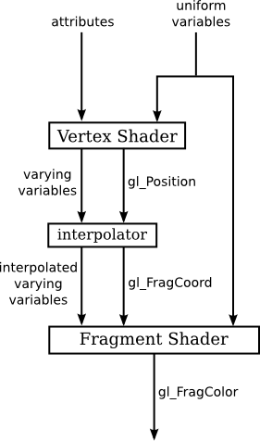
Vertex shader program
As one of its outputs, the vertex shader must specify the coordinates of the vertex in the clip coordinate system by assigning a value to a special variable named gl_Position
The position is often computed by applying a transformation to the attribute that represents the coordinates in the object coordinate system, but exactly how the position is computed is up to the programmer

Slide 44
Vertex shader program
After the positions of all the vertices in the primitive have been computed, a fixed-function stage in the pipeline clips away the parts of the primitive whose coordinates are outside the range of valid clip coordinates (−1 to 1 along each coordinate axis).
The primitive is then rasterized; that is, it is determined which pixels lie inside the primitive.
The GPU then calls the fragment shader once for each pixel that lies in the primitive.

Slide 45
Fragment shader program
The fragment shader has access to uniform variables (but not attributes).
It can also use a special variable named gl_FragCoord that contains the clip coordinates of the pixel.
Pixel coordinates are computed by interpolating the values of gl_Position that were specified by the vertex shader.
The interpolation is done by another fixed-function stage that comes between the vertex shader and the fragment shader.

Slide 46
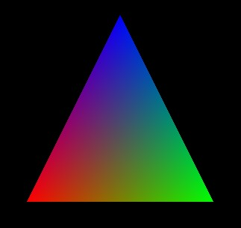
Varying variables
In OpenGL, the color of an interior pixel is computed by interpolating the color at the vertices.
In GLSL, this is implemented using varying variables.

Slide 47
Varying variables
A varying variable is declared both in the vertex shader and in the fragment shader.
The vertex shader assigns a value to the varying variable.
The interpolator interpolates the values to produce a value for each pixel.
When the fragment shader is executed for a given pixel, the value of the varying variable is the interpolated value for that pixel.

Slide 48
Varying variables
Varying variables communicate data from the vertex shader to the fragment shader.
They are defined in the shader source code, not used or referred to in the JavaScript side of the API.
Note that it is entirely up to the programmer to decide what varying variables to define and what to do with them.

Slide 49
Fragment Shader
The job of the fragment shader is simply to specify a color for the pixel.
It does that by assigning a value to a special variable named gl_FragColor.
That value will then be used in the remaining fixed-function stages of the pipeline.

Slide 50
Summarize
The JavaScript side sends values for attributes and uniform variables to the GPU and then issues a command to draw a primitive.
The GPU executes the vertex shader once for each vertex.
The vertex shader can use the values of attributes and uniforms.
  It assigns values to gl_Position and to any varying variables that exist in the shader.
After clipping, rasterization, and interpolation, the GPU executes the fragment shader once for each pixel in the primitive.
The fragment shader can use the values of varying variables, uniform variables, and gl_FragCoord.
  It computes a value for gl_FragColor.

Slide 51
Notes on GLSL ES 3.00
There is no special variable gl_FragColor.
  The fragment shader must define its own output variable to represent the color.
Attribute variables become "in" variables, since they are inputs to the vertex shader, and varying variables become "out" variables in the vertex shader and "in" variables in the fragment shader. The variable gl_FragColor is replaced by an "out" variable in the fragment shader

Slide 52
GLSL Qualifiers
Attribute
Varying
Uniform
Become the inputs for Vertex shaders
Declared once globally in Vertex shader, and cannot be modified respectively
Lead the shader’s variable’s value varies across vertices
As the outputs of Vertex shaders; and as the inputs for Fragment shaders
Declared twice globally: One is in Vertex shader, the other one is in Fragment shader
Interpolated automatically by Rasterizer
Become the inputs for any or both shaders
Lead the shaders’ variable’s value remain the same across vertices and fragments
Cannot be modified just like other qualifiers. To change its value across the frames, we need to modify its corresponding variable in JS application

Slide 53
Shaders’ Source Code
Vertex Shader
Fragment Shader
Let’s have some naming conventions for both GLSL and JS applications:
All the names of attribute variables are started with a.
All the names of varying variables are started with v.
All the names of uniform variables are started with u.
attribute vec4 aPosition;
attribute vec4 aColor;
varying vec4 vColor;
void main()
{
gl_Position = aPosition;
vColor = aColor;
}
precision mediump float;
varying vec4 vColor;
uniform vec4 uAmbient;
void main()
{
gl_FragColor = uAmbient + vColor;
}

Slide 54
Sending Colors as an Attribute
var vertexBuffer = gl.createBuffer();
gl.bindBuffer( gl.ARRAY_BUFFER, vertexBuffer );
gl.bufferData( gl.ARRAY_BUFFER, new Float32Array (colors), gl.STATIC_DRAW );
var aColor = gl.getAttribLocation( program, ”aColor" );
gl.vertexAttribPointer( aColor, 3, gl.FLOAT, false, 0, 0 );
gl.enableVertexAttribArray( aColor );

Slide 55
Sending Colors as a Uniform
In GLSL Shader
in JS Application
vec4 color = vec4(1.0, 0.0, 0.0, 1.0);
uColor = gl.getUniformLocation( program, ” uColor " );
gl.uniform4f( uColor, color);
uniform vec4 uColor;
void main()
{
gl_FragColor = uColor;
}

Slide 56
WebGL’s Function Structure
function name
dimension
gl.uniform3f(x,y,z)
variable representing canvas’s context
x,y,z arefloat variabels
gl.uniform3fv(p)
p is a vector

Slide 57
Primitive Objects
0D
1D
2D

Slide 58
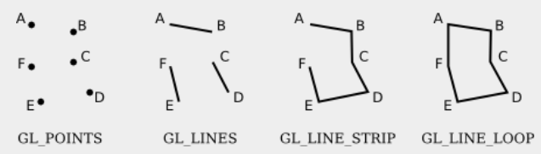
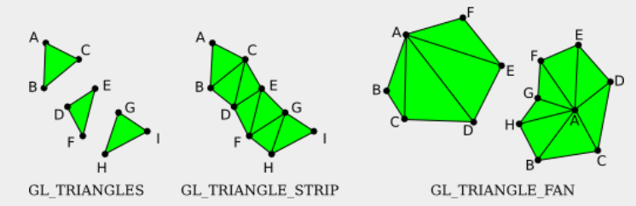
Primitive objects in WebGL
In WegGL, the seven types of primitive are identified by the constants
  gl.POINTS
  gl.LINES
  gl.LINE_STRIP
  gl.LINE_LOOP
  gl.TRIANGLES
  gl.TRIANGLE_STRIP
  gl.TRIANGLE_FAN
where gl is a WebGL graphics context.

Slide 59
How to Draw a Triangle
Put the triangle geometry data into an array
var points = [
vec3 (-0.5, -0.5, 0.0),
vec3 ( 0.5, -0.5, 0.0),
vec3 ( 0.0, 0.5, 1.0)
];
Send the array to GPU
Tell GPU to draw the triangle
(0.0, 0.5, 1.0)
(-0.5, -0.5, 0.0)
(0.5, -0.5, 0.0)

Slide 60

Next Week Topic
Example 1 and More on WebGL & GLSL

Slide 61
GLSL
Basic data types: float, int, and bool
Other predefined data types:
  vec3 represents a vector in 3D, the value is a list of three floating-point numbers
  vec2 and vec4
Global variable declarations in a vertex shader can be marked as attribute, varying, or uniform (or as in, out, or uniform in GLSL ES 3.00)
  If the declared variable has no modifiers, then the variable is a local variable

Slide 62
Values for Uniforms
(JavaScript side)
gl.getUniformLocation
  get a reference to a uniform variable in a shader program
  gl refers to the WebGL graphics context
  Params: the compiled program identifier and the uniform variable name in the shader
  Example:
  colorUniformLoc = gl.getUniformLocation( prog, "color" );
gl.uniform*
  set the value of the uniform variable
  * : a suffix that tells the number and type of values
  Example:
  gl.uniform3f( colorUniformLoc, 1, 0, 0 );

Slide 63
Values for Attributes
(JavaScript side)
Before data can be transferred from JavaScript into an attribute variable, it must be placed into a typed array, e.g., Float32Array
For use in WebGL, the attribute data must be transferred into a VBO (vertex buffer object), a block of memory that is accessible to the GPU
  Create a VBO
  colorBuffer = gl.createBuffer();
  Bind the data with the VBO
  gl.bindBuffer( gl.ARRAY_BUFFER, colorBuffer );
  Transfer data into the VBO
  gl.bufferData(gl.ARRAY_BUFFER, colorArray, gl.STATIC_DRAW);
Notes:
The third parameter to gl.bufferData is one of the constants gl.STATIC_DRAW, gl.STREAM_DRAW, or gl.DYNAMIC_DRAW. gl.STATIC_DRAW means that you intend to use the data many times without changing it. gl.STEAM_DRAW, is for data that will be used only once, or at most a few times. gl.DYNAMIC_DRAW is somewhere between the other two values; it is meant for data that will be used multiple times, but with modifications.

Slide 64
Values for Attributes
(JavaScript side)
We also have to tell WebGL to use the VBO as the source of values for the attribute
  Get the location of the attribute in the shader program
  colorAttribLoc = gl.getAttribLocation(prog, "a_color");
  To take the values of an attribute from a VBO, enable the use of a VBO for that attribute
  gl.enableVertexAttribArray( colorAttribLoc );
  Use of data from the VBO can be turned off by:
  gl.disableVertexAttribArray( colorAttribLoc );
  tell WebGL which buffer contains the data and how the bits in that buffer are to be interpreted
  gl.bindBuffer( gl.ARRAY_BUFFER, colorBuffer );
  gl.vertexAttribPointer( colorAttribLoc, 3, gl.FLOAT, false, 0, 0 );
Notes:
The first parameter to gl.vertexAttribPointer is the attribute location. The second is the number of values per vertex. For example, if you are providing values for a vec2, the second parameter will be 2 and you will provide two numbers per vertex; for a vec3, the second parameter would be 3; for a float, it would be 1. The third parameter specifies the type of each value. Here, gl.FLOAT indicates that each value is a 32-bit floating point number. Other values include gl.BYTE, gl.UNSIGNED_BYTE, gl.UNSIGNED_SHORT, and gl.SHORT for integer values.

Slide 65
Values for Attributes
(JavaScript side)
In summary, using a VBO to provide values for an attribute requires six separate commands, and that is in addition to generating the data and placing it in a typed array
  colorAttribLoc = gl.getAttribLocation( prog, "a_color" );
  colorBuffer = gl.createBuffer();
  gl.enableVertexAttribArray( colorAttribLoc );
  gl.bindBuffer( gl.ARRAY_BUFFER, colorBuffer );
  gl.vertexAttribPointer( colorAttribLoc, 3, gl.FLOAT, false, 0, 0 );
  gl.bufferData( gl.ARRAY_BUFFER, colorArray, gl.STATIC_DRAW );
Notes:
The first three commands are often done as part of initialization. gl.bufferData would be called whenever the data for the attribute needs to be changed; it might be used just once during initialization, or it might be used whenever the data needs to be modified. gl.bindBuffer must be called before gl.vertexAttribPointer or gl.bufferData, since it establishes the VBO that is used by those two commands. Remember that all of this must be done for every attribute that is used in the shader program.

Slide 66
Drawing a Primitive in WebGL

Slide 67
Drawing a Primitive
It is done after the shader program has been created and values have been set up for the uniform variables and attributes:
gl.drawArrays( primitiveType, startVertex, vertexCount );
  Before calling gl.drawArrays, you will have placed attribute values for some number of vertices into one or more VBOs.
  When the primitive is rendered, the attribute values for enabled attributes are pulled from the VBOs.
  The startVertex is the starting vertex number of the data within the VBOs, and vertexCount is the number of vertices in the primitive.
  For example, the command for drawing a single triangle might be
  gl.drawArrays( gl.TRIANGLES, 0, 3 );

Slide 68
Vertex Array Objects
A typical 3D graphics program would use attributes for vertex coordinates, normal vectors, material properties, and texture coordinates.
WebGL 2.0 introduced Vertex Array Objects (VAOs).
What is VAO?
  A section of memory, typically stored on the graphics card.
  Holds settings that are used by rendering functions such as gl.drawArrays()
WebGL 2.0 has a default VAO, which it uses when no other VAO has been selected.
To use an alternative VAO
  Create the alternative VAO
  vao = gl.createVertexArray();
  Bind the VAO
  gl.bindVertexArray(vao);
To go back to using the default VAO, call gl.bindVertexArray(0)
Notes:
The idea is that a program that draws several objects can use a different VAO for each object. The VAO for an object must be bound when the settings for the object are configured. But before drawing the object, the program simply needs to bind the VAO for that object. That single function call replaces a potentially a large number of function calls that would be needed to restore the appropriate settings for each attribute individually. The advantage is more than just a more nicely organized program—it is also much more efficient, since only one command needs to be sent to the GPU to configure all of the attributes.

Slide 69
Instanced Drawing
It's common for a scene to contain multiple copies of the same primitive (that is, using the same vertex coordinates), but with different transformations, colors, or other properties for each copy.
Using WebGL 2.0, we can draw all those copies with a single function call: gl.drawArraysInstanced()
This is called instanced drawing or instancing, and the individual copies of the primitive are called instances.
Instanced properties—the properties that vary from one instance to another—are things that would likely be uniform variables when drawing each instance separately.
Nevertheless, the properties are represented by attribute variables in the shader program, not uniform variables, and they are configured as attributes.

Slide 70
Instanced Drawing
To specify that an attribute is an instanced property, you just need to specify a "divisor" for that attribute by calling
gl.vertexAttribDivisor( attribID, divisor );
  attribID: the identifier for the attribute, as returned by gl.getAttribLocation().
  divisor: a non-negative integer.
    Passing zero as the divisor will turn off instancing for the attribute.
    If divisor is positive, then each value of the attribute will apply to that many instances.
      For example, if divisor is 3, then the first entry in the attribute value array applies to the first, second, and third instances; the second value in the array applies to the fourth, fifth, and sixth instances; and so on.
    In practice, the value of divisor is usually one, meaning that each instance has its own entry in the attribute value array.

Slide 71
Instanced Drawing
Do not forget to
  enable the attribute, load data for it into a VBO, and configure it with gl.vertexAttribPointer
  draw the primitive using gl.drawArraysInstanced(), not with gl.drawArrays()

Slide 72
First Examples

Slide 73
More about WebGL context options
A WebGL graphics context is created by the function canvas.getContext, where canvas is a reference to the <canvas> element where the graphics context will draw.
This function takes an optional second parameter that can be used to set the value of certain options in the graphics context.
  alpha
  depth
  antialias
  preserveDrawingBuffer
let options = {
alpha: false,
depth: false
};
gl = canvas.getContext( "webgl2", options );

Slide 74
A bit of GLSL
A vertex or fragment shader can contain global variable declarations, type definitions, and function definitions.
One of the functions must be main(), which is the entry point for the shader; that is, it is the function that is called by the GPU to process the vertex or fragment.
void main() {
.
.
.
}

Slide 75
A bit of GLSL
gl_Position is the special built-in variable that is used in the vertex shader to give the coordinates of the vertex.
gl_Position is of type vec4, requiring four numbers, because the coordinates are specified as homogeneous coordinates.
The special variable gl_FragCoord in the fragment shader is also a vec4, giving the coordinates of the pixel as homogeneous coordinates.
And gl_FragColor is a vec4, giving the four RGBA color components for the pixel.

Slide 76
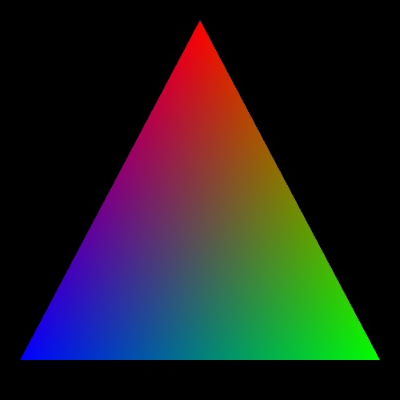
The First Example
Notes:
https://math.hws.edu/graphicsbook/source/webgl/webgl-rgb-triangle.html

Slide 77
In-class Exercises

Slide 78
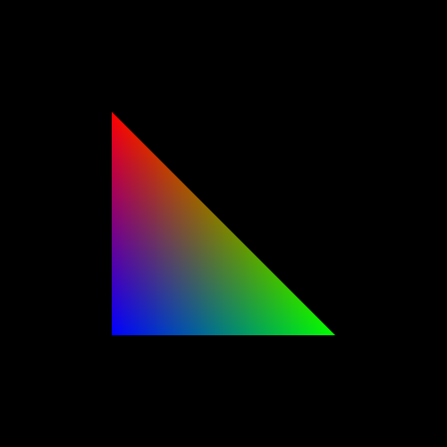
Exercise 1

Slide 79
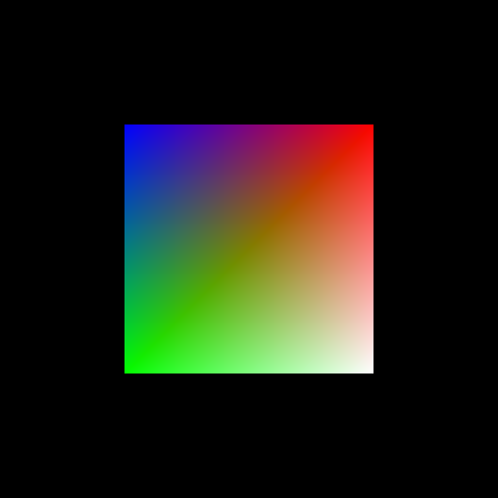
Exercise 2

